Slide 1
Boolean Algebra
Boolean algebra is a mathematical system for the manipulation of variables that can have one of two values.
  In formal logic, these values are “true” and “false.”
  In digital systems, these values are “on” and “off,” 1 and 0, or “high” and “low.”
Boolean expressions are created by performing operations on Boolean variables.
  Common Boolean operators include AND, OR, and NOT.

Slide 2
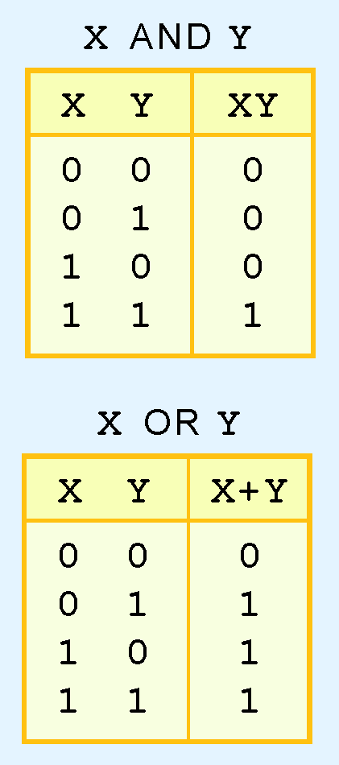
Boolean Algebra
A Boolean operator can be completely described using a truth table.
The truth table for the Boolean operators AND and OR are shown at the right.
The AND operator is also known as a Boolean product. The OR operator is the Boolean sum.

Slide 3
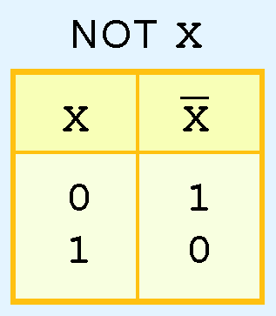
Boolean Algebra
The truth table for the Boolean NOT operator is shown at the right.
The NOT operation is most often designated by an overbar. It is sometimes indicated by a prime mark ( ‘ ) or an “elbow” (¬).

Slide 4
Boolean Algebra
A Boolean function has:
  At least one Boolean variable,
  At least one Boolean operator, and
  At least one input from the set {0,1}.
It produces an output that is also a member of the set {0,1}.
Now you know why the binary numbering system is so handy in digital systems.

Slide 5
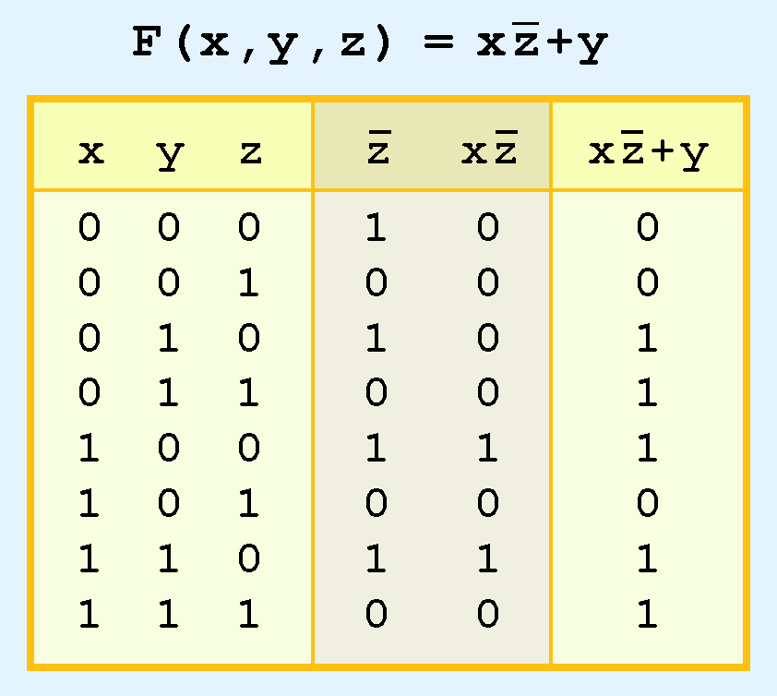
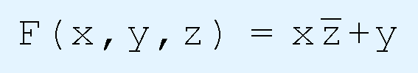
Boolean Algebra
The truth table for the Boolean function:
is shown at the right.
To make evaluation of the Boolean function easier, the truth table contains extra (shaded) columns to hold evaluations of subparts of the function.

Slide 6
Boolean Algebra
As with common arithmetic, Boolean operations have rules of precedence.
The NOT operator has highest priority, followed by AND and then OR.
This is how we chose the (shaded) function subparts in our table.

Slide 7
Boolean Algebra
Digital computers contain circuits that implement Boolean functions.
The simpler that we can make a Boolean function, the smaller the circuit that will result.
  Simpler circuits are cheaper to build, consume less power, and run faster than complex circuits.
With this in mind, we always want to reduce our Boolean functions to their simplest form.
There are a number of Boolean identities that help us to do this.

Slide 8
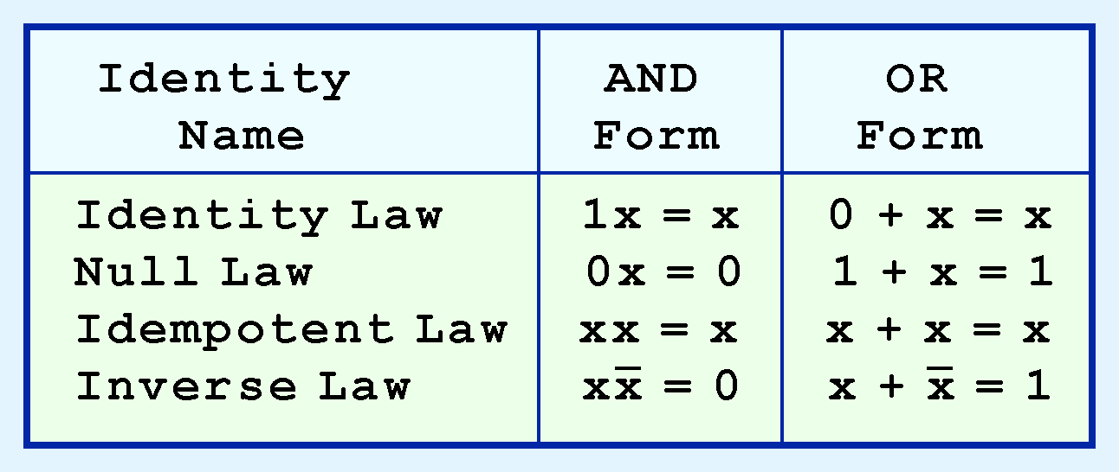
Boolean Algebra
Most Boolean identities have an AND (product) form as well as an OR (sum) form. We give our identities using both forms. Our first group is rather intuitive:

Slide 9
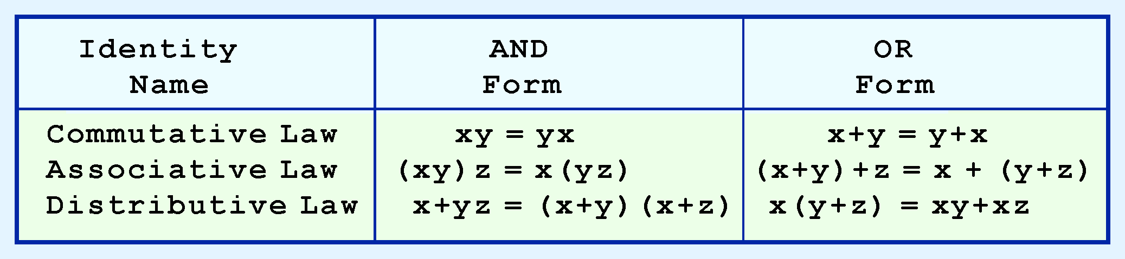
Boolean Algebra
Our second group of Boolean identities should be familiar to you from your study of algebra:

Slide 10
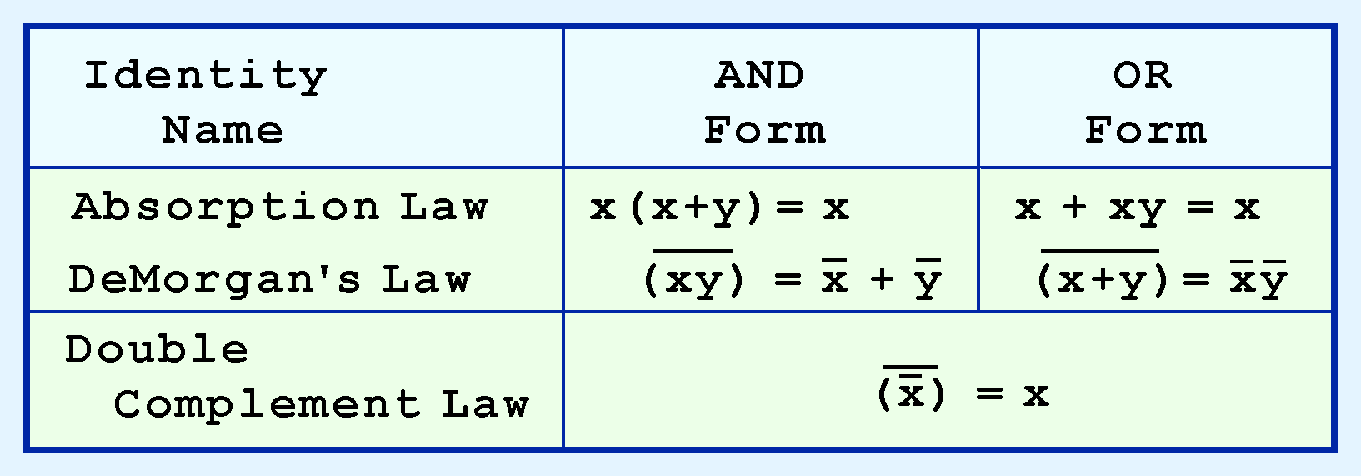
Boolean Algebra
Our last group of Boolean identities are perhaps the most useful.
If you have studied set theory or formal logic, these laws are also familiar to you.

Slide 11

Boolean Algebra
We can use Boolean identities to simplify the function:
as follows:

Slide 12
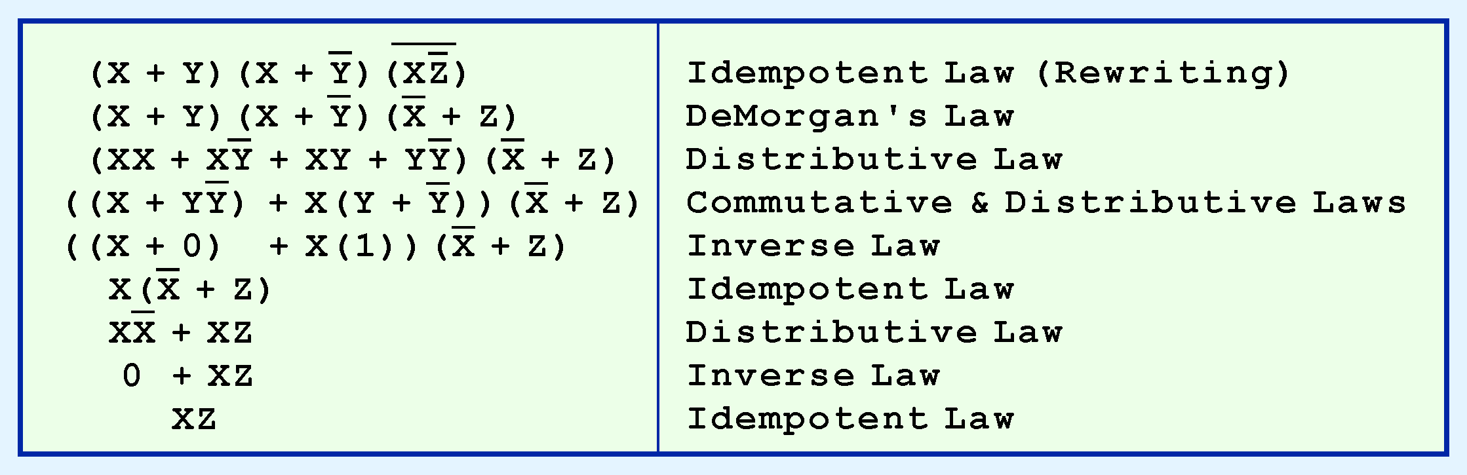

Slide 13
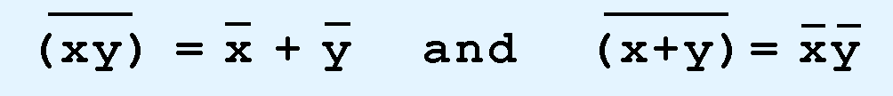
Boolean Algebra
Sometimes it is more economical to build a circuit using the complement of a function (and complementing its result) than it is to implement the function directly.
DeMorgan’s law provides an easy way of finding the complement of a Boolean function.
Recall DeMorgan’s law states:

Slide 14
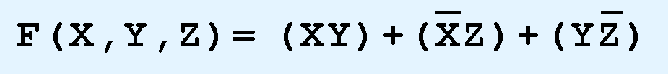
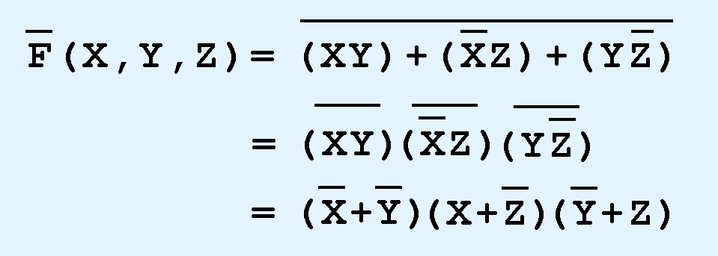
Boolean Algebra
DeMorgan’s law can be extended to any number of variables.
Replace each variable by its complement and change all ANDs to ORs and all ORs to ANDs.
Thus, we find the the complement of:
is:

Slide 15
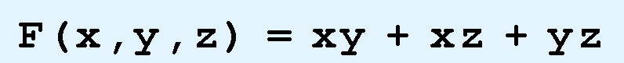
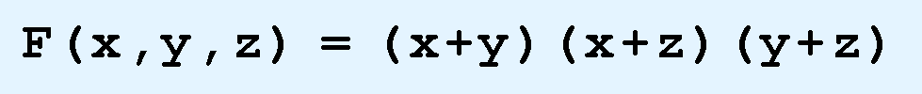
Boolean Algebra
There are two canonical forms for Boolean expressions: sum-of-products and product-of-sums.
  Recall the Boolean product is the AND operation and the Boolean sum is the OR operation.
In the sum-of-products form, ANDed variables are ORed together.
  For example:
In the product-of-sums form, ORed variables are ANDed together:
  For example:

Slide 16
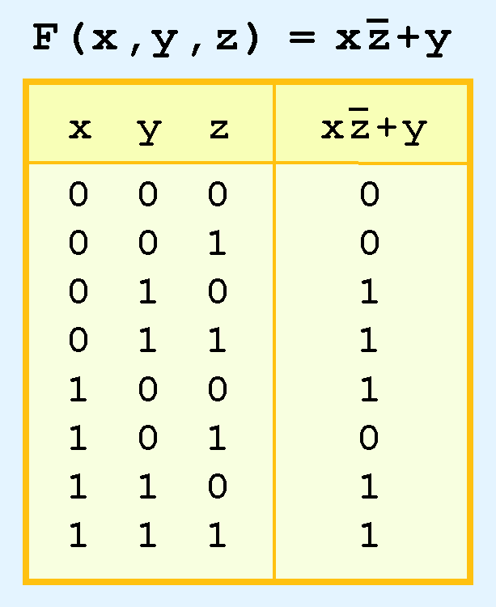
Boolean Algebra
It is easy to convert a function to sum-of-products form using its truth table.
We are interested in the values of the variables that make the function true (=1).
Using the truth table, we list the values of the variables that result in a true function value.
Each group of variables is then ORed together.

Slide 17
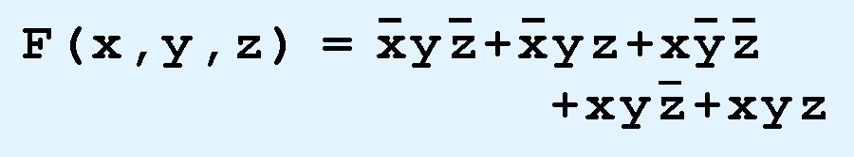
Boolean Algebra
The sum-of-products form for our function is:
We note that this function is not in simplest terms. Our aim is only to rewrite our function in canonical sum-of-products form.

Slide 18
Logic Gates
We have looked at Boolean functions in abstract terms.
In this section, we see that Boolean functions are implemented in digital computer circuits called gates.
A gate is an electronic device that produces a result based on two or more input values.
  In reality, gates consist of one to six transistors, but digital designers think of them as a single unit.
  Integrated circuits contain collections of gates suited to a particular purpose.

Slide 19
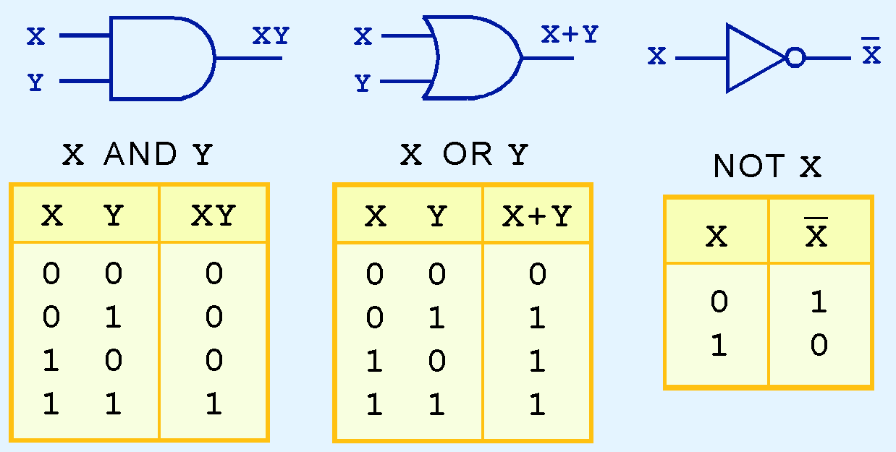
Logic Gates
The three simplest gates are the AND, OR, and NOT gates.
They correspond directly to their respective Boolean operations, as you can see by their truth tables.

Slide 20
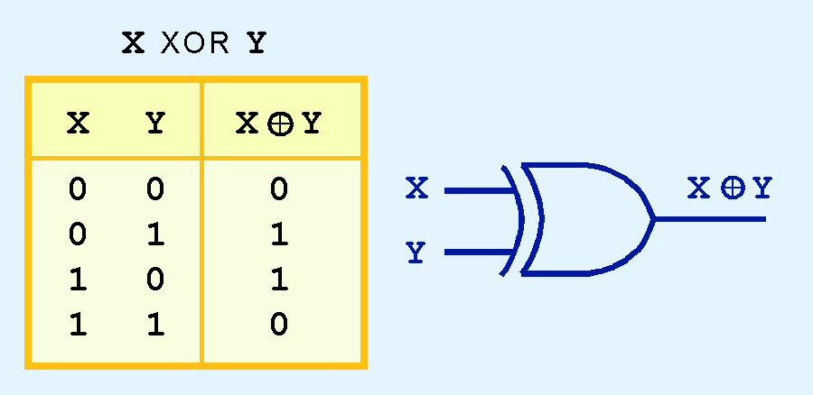
Logic Gates
Another very useful gate is the exclusive OR (XOR) gate.
The output of the XOR operation is true only when the values of the inputs differ.
Note the special symbol ⊕ for the XOR operation.

Slide 21
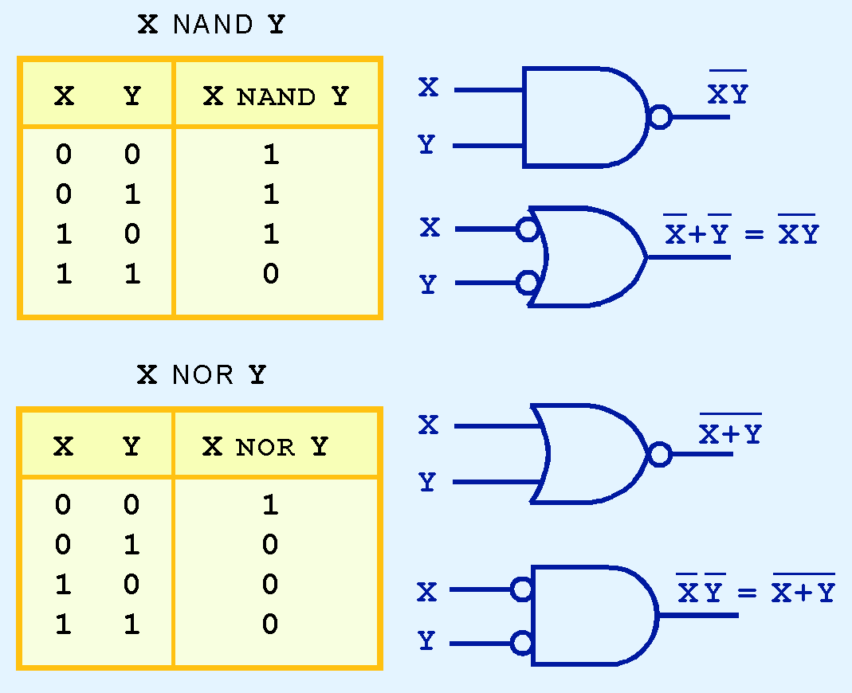
Logic Gates
NAND and NOR are two very important gates. Their symbols and truth tables are shown at the right.

Slide 22
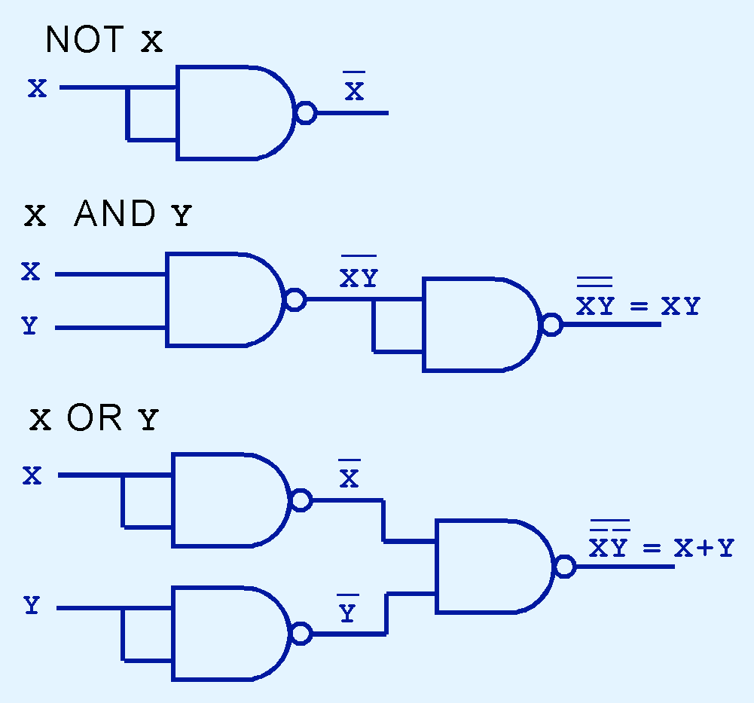
Logic Gates
NAND and NOR are known as universal gates because they are inexpensive to manufacture and any Boolean function can be constructed using only NAND or only NOR gates.

Slide 23
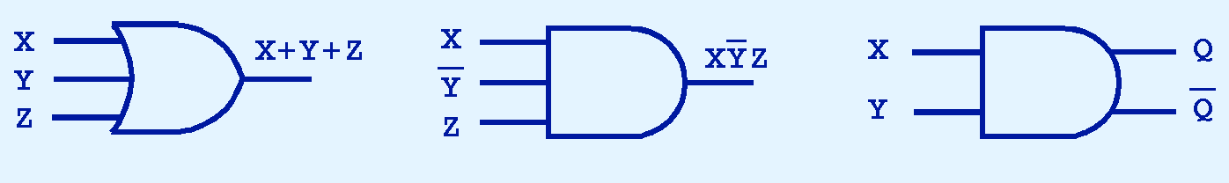
Logic Gates
Gates can have multiple inputs and more than one output.
  A second output can be provided for the complement of the operation.
  We’ll see more of this later.

Slide 24

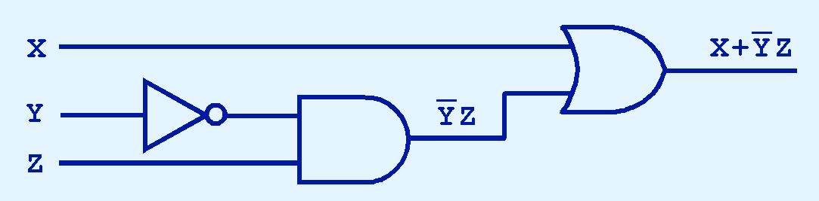
Digital Components
The main thing to remember is that combinations of gates implement Boolean functions.
The circuit below implements the Boolean function:
We simplify our Boolean expressions so that we can create simpler circuits.

Slide 25
Combinational Circuits
We have designed a circuit that implements the Boolean function:
This circuit is an example of a combinational logic circuit.
Combinational logic circuits produce a specified output (almost) at the instant when input values are applied.
  In a later section, we will explore circuits where this is not the case.

Slide 26
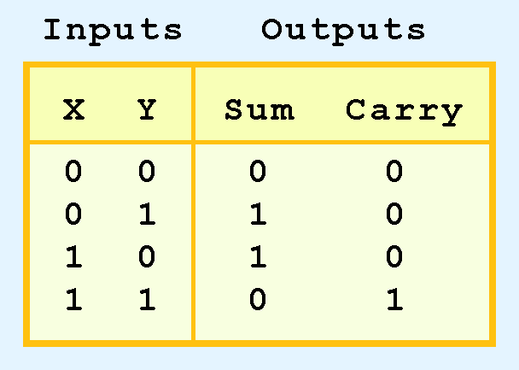
Combinational Circuits
Combinational logic circuits give us many useful devices.
One of the simplest is the half adder, which finds the sum of two bits.
We can gain some insight as to the construction of a half adder by looking at its truth table, shown at the right.

Slide 27
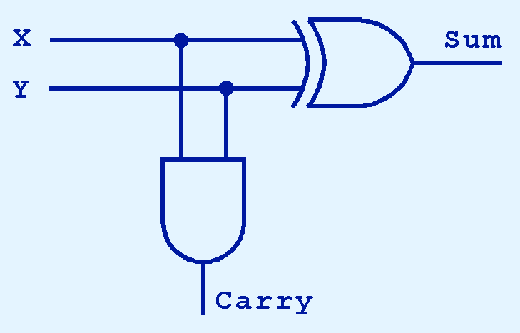
Combinational Circuits
As we see, the sum can be found using the XOR operation and the carry using the AND operation.

Slide 28
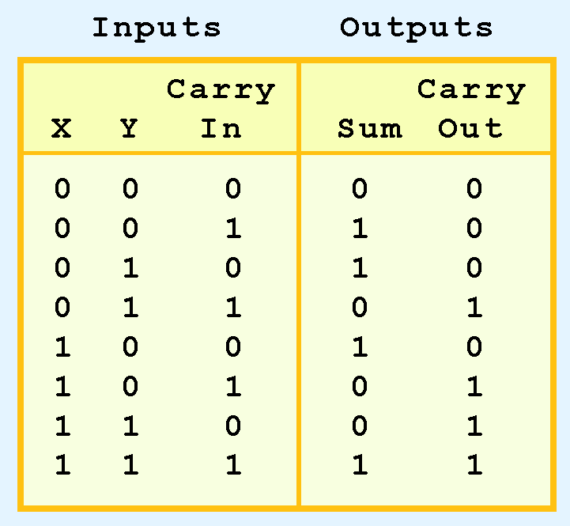
Combinational Circuits
We can change our half adder into to a full adder by including gates for processing the carry bit.
The truth table for a full adder is shown at the right.

Slide 29
Combinational Circuits
How can we change the half adder shown below to make it a full adder?

Slide 30
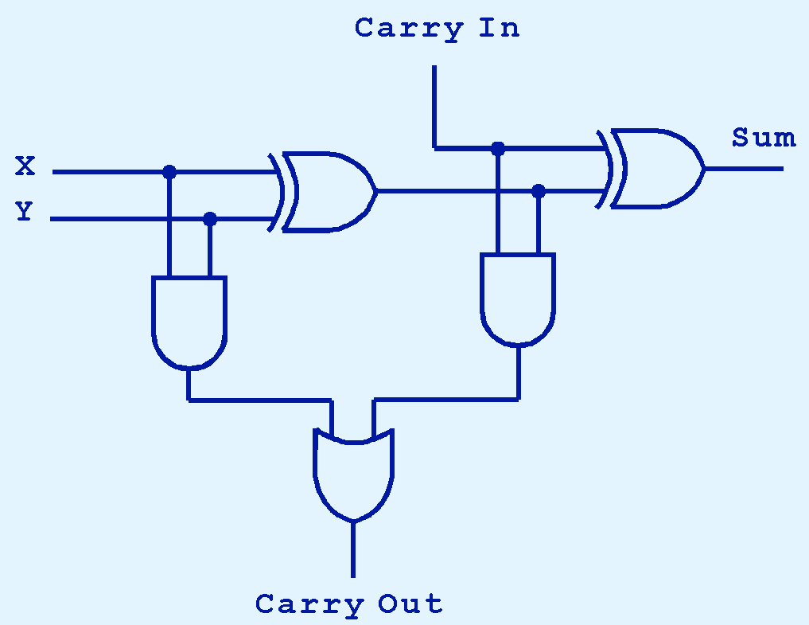
Combinational Circuits
Here’s our completed full adder.

Slide 31

Combinational Circuits
Just as we combined half adders to make a full adder, full adders can connected in series.
The carry bit “ripples” from one adder to the next; hence, this configuration is called a ripple-carry adder.
Today’s systems employ more efficient adders.

Slide 32
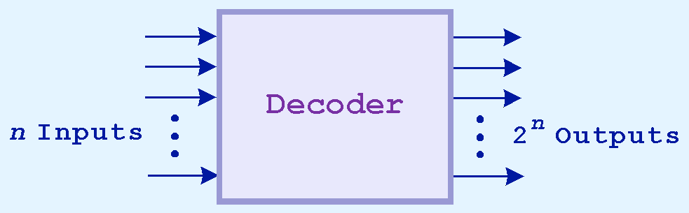
Combinational Circuits
Decoders are another important type of combinational circuit.
Among other things, they are useful in selecting a memory location according a binary value placed on the address lines of a memory bus.
Address decoders with n inputs can select any of 2^{n} locations.
This is a block diagram for a decoder.

Slide 33
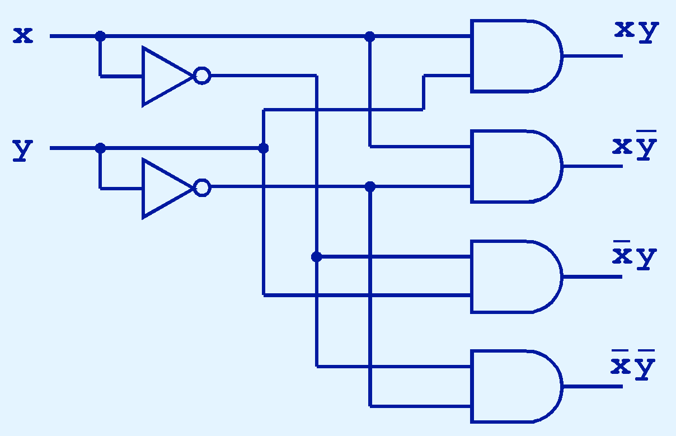
Combinational Circuits
This is what a 2-to-4 decoder looks like on the inside.
If x = 0 and y = 1, which output line is enabled?

Slide 34
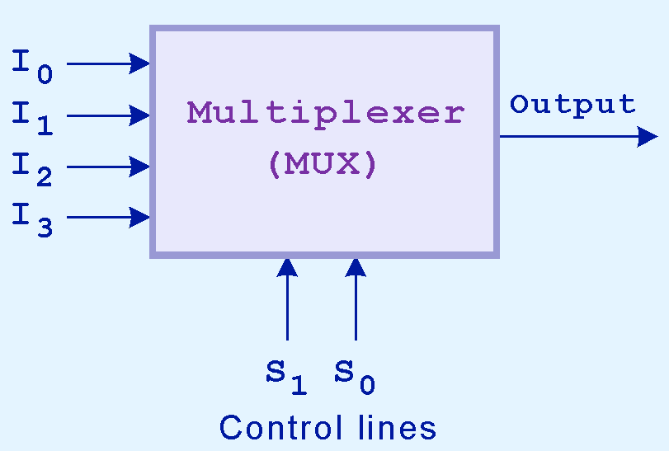
Combinational Circuits
A multiplexer does just the opposite of a decoder.
It selects a single output from several inputs.
The particular input chosen for output is determined by the value of the multiplexer’s control lines.
To be able to select among n inputs, log₂n control lines are needed.
This is a block diagram for a multiplexer.

Slide 35
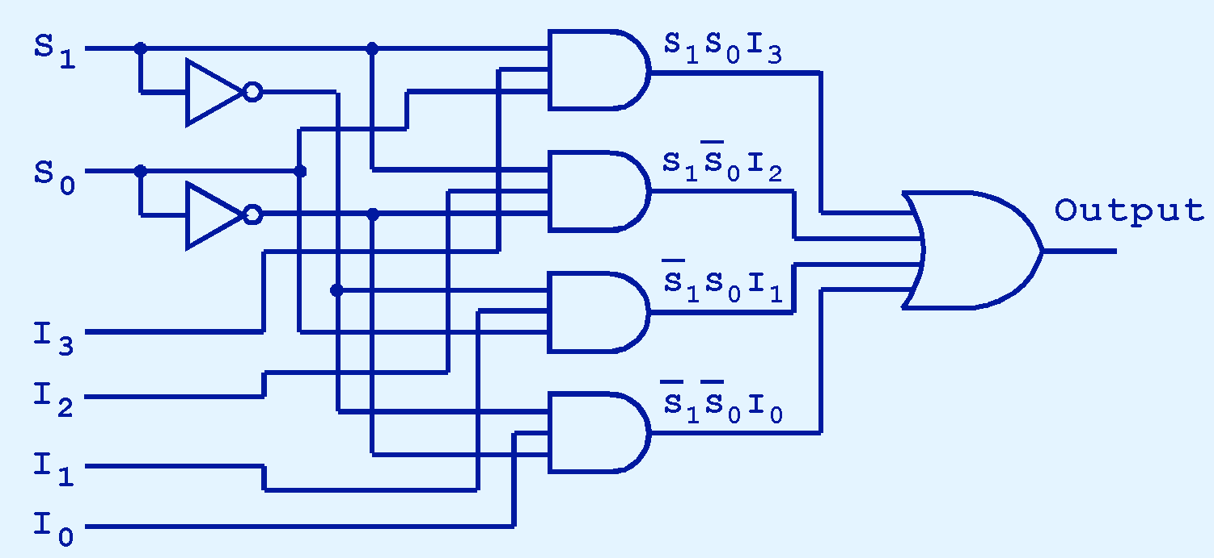
Combinational Circuits
This is what a 4-to-1 multiplexer looks like on the inside.
If S₀ = 1 and S₁ = 0, which input is transferred to the output?

Slide 36
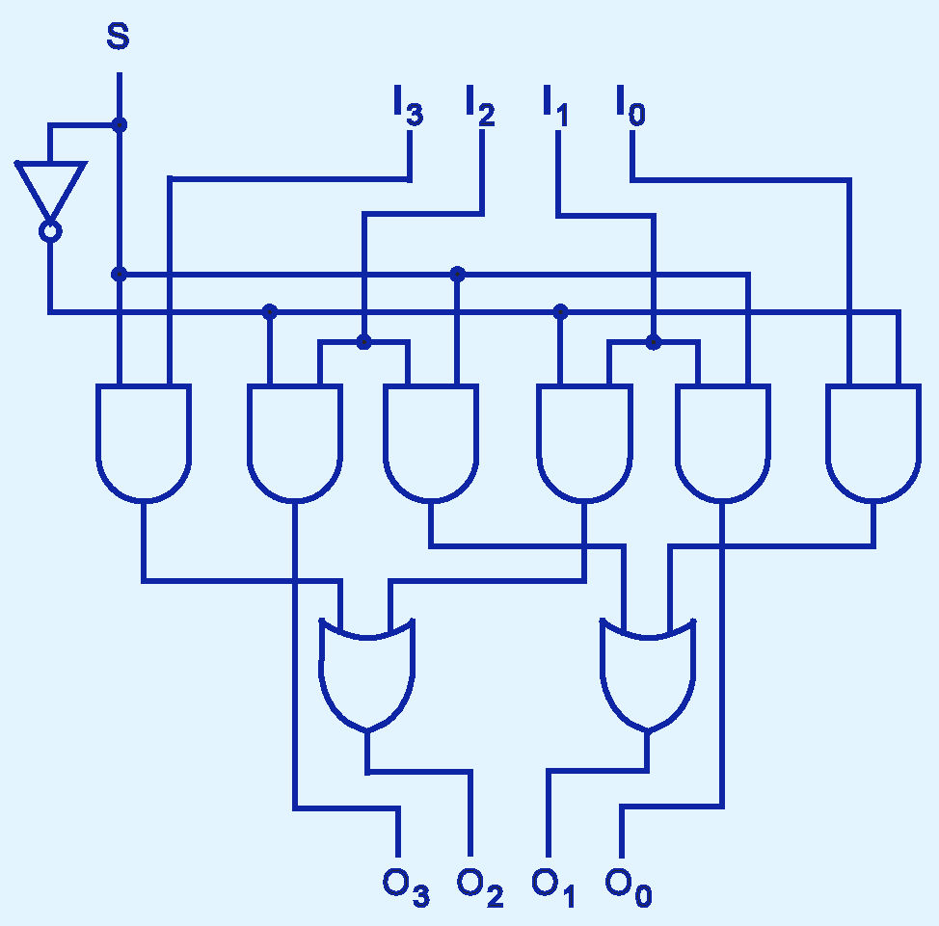
Combinational Circuits
This shifter moves the bits of a nibble one position to the left or right.
If S = 0, in which direction do the input bits shift?

Slide 37
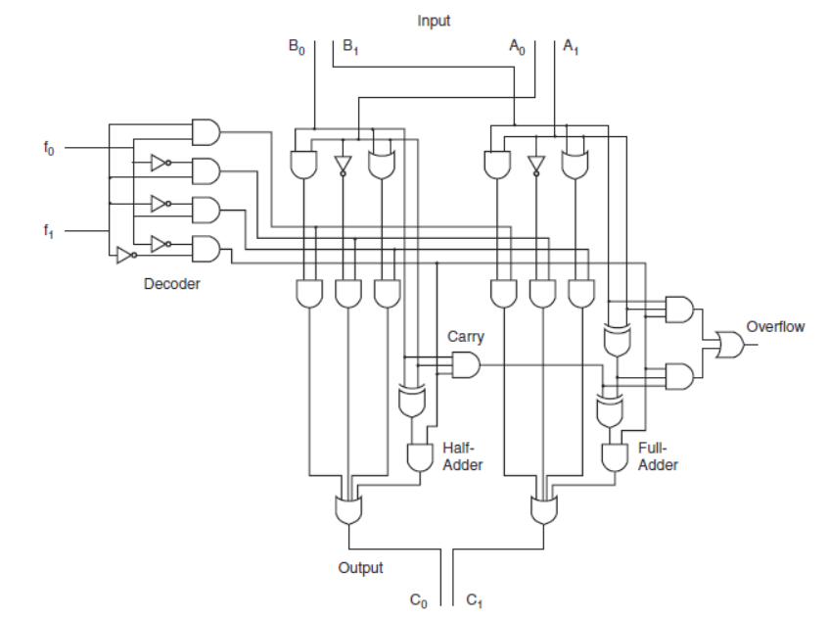

Slide 38
Sequential Circuits

Slide 39
Sequential Circuits
Combinational logic circuits are perfect for situations when we require the immediate application of a Boolean function to a set of inputs.
There are other times, however, when we need a circuit to change its value with consideration to its current state as well as its inputs.
  These circuits have to “remember” their current state.
Sequential logic circuits provide this functionality for us.

Slide 40

Sequential Circuits
As the name implies, sequential logic circuits require a means by which events can be sequenced.
State changes are controlled by clocks.
  A “clock” is a special circuit that sends electrical pulses through a circuit.
Clocks produce electrical waveforms such as the one shown below.

Slide 41
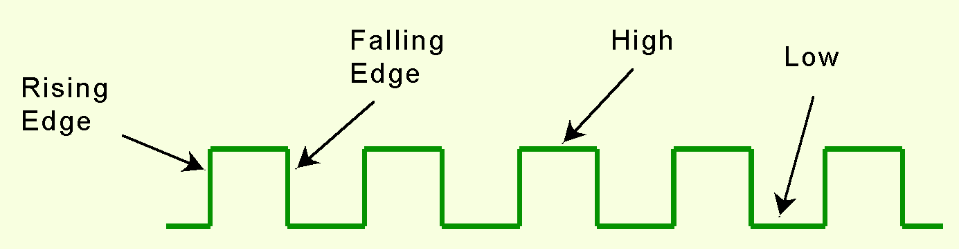
Sequential Circuits
State changes occur in sequential circuits only when the clock ticks.
Circuits can change state on the rising edge, falling edge, or when the clock pulse reaches its highest voltage.

Slide 42
Sequential Circuits
Circuits that change state on the rising edge, or falling edge of the clock pulse are called edge-triggered.
Level-triggered circuits change state when the clock voltage reaches its highest or lowest level.

Slide 43
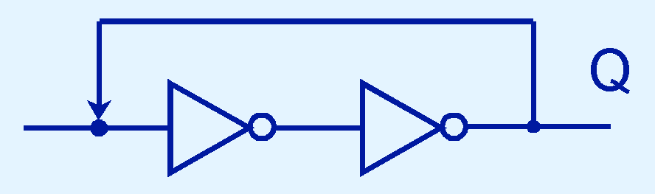
Sequential Circuits
To retain their state values, sequential circuits rely on feedback.
Feedback in digital circuits occurs when an output is looped back to the input.
A simple example of this concept is shown below.
  If Q is 0 it will always be 0, if it is 1, it will always be 1. Why?

Slide 44
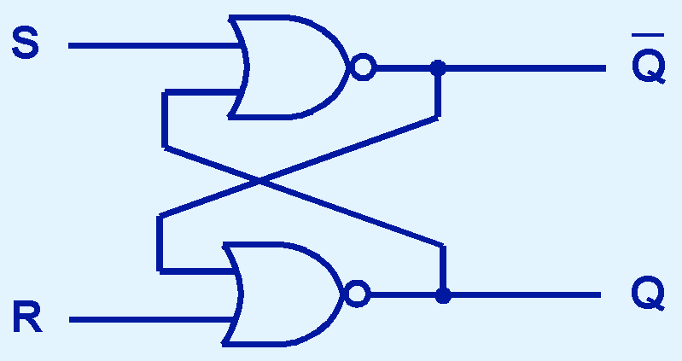
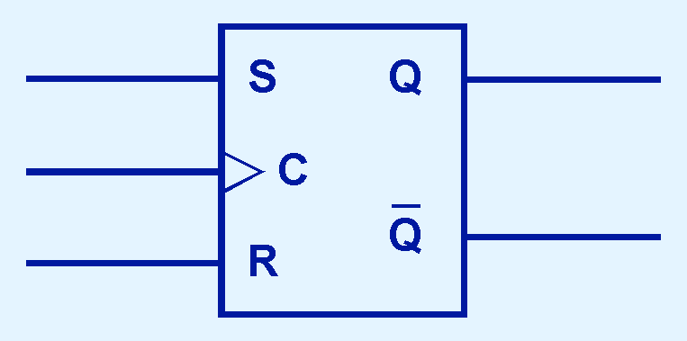
Sequential Circuits
You can see how feedback works by examining the most basic sequential logic components, the SR flip-flop.
  The “SR” stands for set/reset.
The internals of an SR flip-flop are shown below, along with its block diagram.

Slide 45
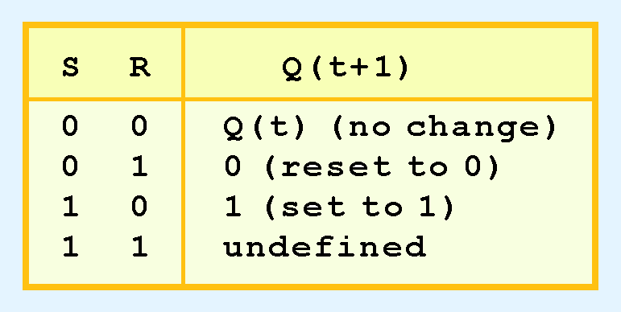
Sequential Circuits
The behavior of an SR flip-flop is described by a characteristic table.
Q(t) means the value of the output at time t. Q(t+1) is the value of Q after the next clock pulse.

Slide 46
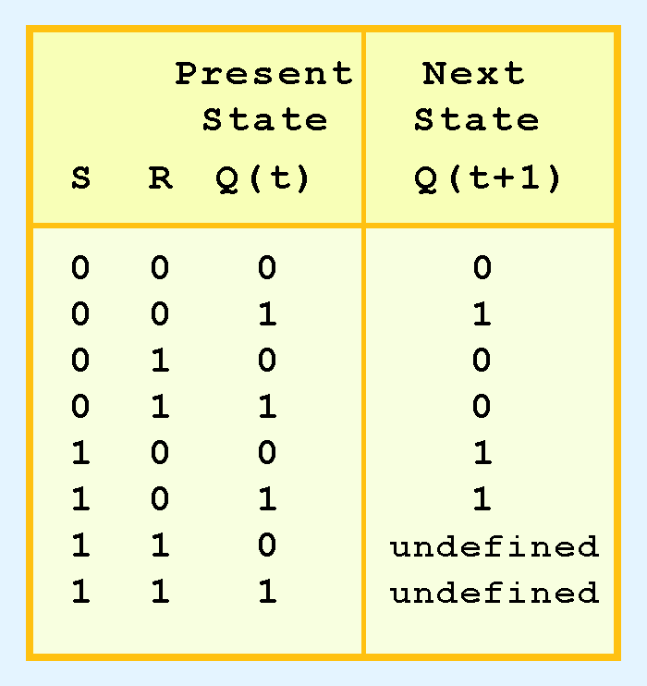
Sequential Circuits
The SR flip-flop actually has three inputs: S, R, and its current output, Q.
Thus, we can construct a truth table for this circuit, as shown at the right.
Notice the two undefined values. When both S and R are 1, the SR flip-flop is unstable.

Slide 47
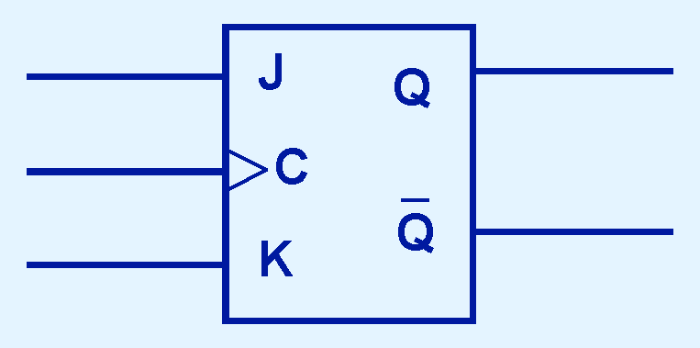
Sequential Circuits
If we can be sure that the inputs to an SR flip-flop will never both be 1, we will never have an unstable circuit. This may not always be the case.
The SR flip-flop can be modified to provide a stable state when both inputs are 1.
• This modified flip-flop is called a JK flip-flop, shown at the right.
- The “JK” is in honor of
Jack Kilby.

Slide 48
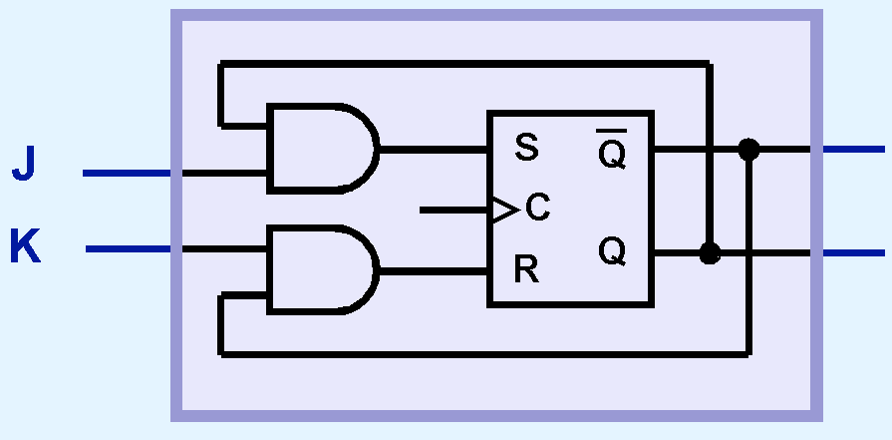


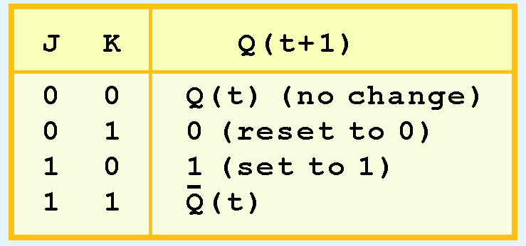
Sequential Circuits
At the right, we see how an SR flip-flop can be modified to create a JK flip-flop.
The characteristic table indicates that the flip-flop is stable for all inputs.

Slide 49
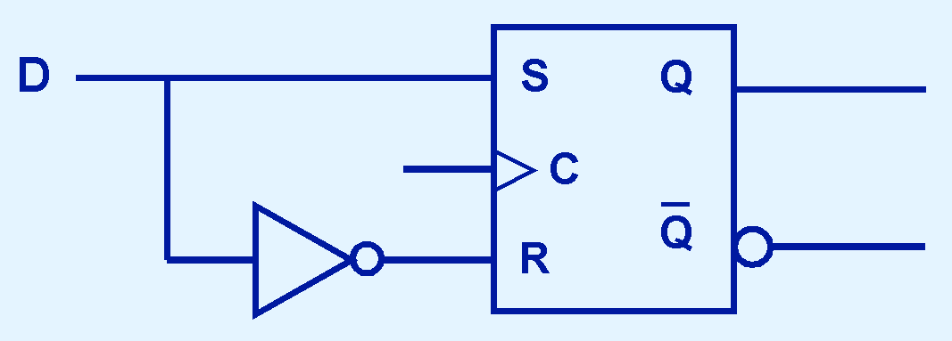
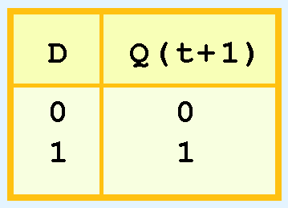
Sequential Circuits
Another modification of the SR flip-flop is the D flip-flop, shown below with its characteristic table.
You will notice that the output of the flip-flop remains the same during subsequent clock pulses. The output changes only when the value of D changes.

Slide 50
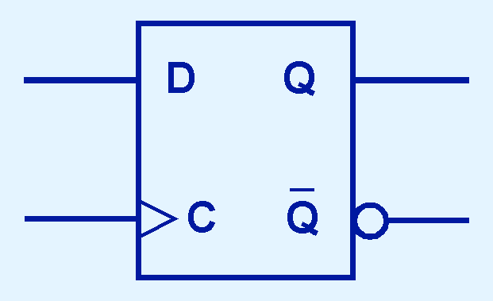
Sequential Circuits
The D flip-flop is the fundamental circuit of computer memory.
  D flip-flops are usually illustrated using the block diagram shown below.
The characteristic table for the D flip-flop is shown at the right.

Slide 51
Sequential Circuits
The behavior of sequential circuits can be expressed using characteristic tables or finite state machines (FSMs).
  FSMs consist of a set of nodes that hold the states of the machine and a set of arcs that connect the states.
Moore and Mealy machines are two types of FSMs that are equivalent.
  They differ only in how they express the outputs of the machine.
Moore machines place outputs on each node, while Mealy machines present their outputs on the transitions.

Slide 52
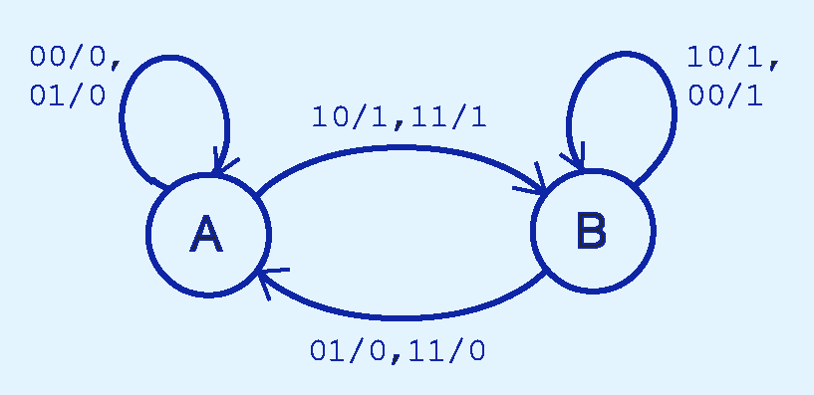
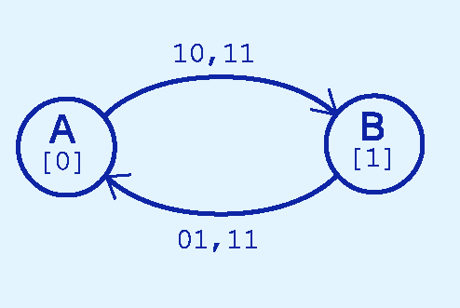
Sequential Circuits
The behavior of a JK flop-flop is depicted below by a Moore machine (left) and a Mealy machine (right).

Slide 53
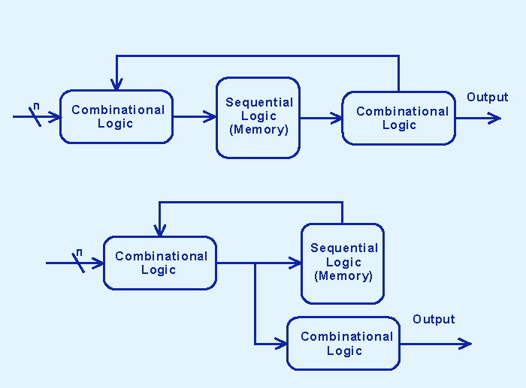
Sequential Circuits
Although the behavior of Moore and Mealy machines is identical, their implementations differ.
This is our Moore machine.

Slide 54
Sequential Circuits
Although the behavior of Moore and Mealy machines is identical, their implementations differ.
This is our Mealy machine.

Slide 55
Sequential Circuits
It is difficult to express the complexities of actual implementations using only Moore and Mealy machines.
  For one thing, they do not address the intricacies of timing very well.
  Secondly, it is often the case that an interaction of numerous signals is required to advance a machine from one state to the next.
For these reasons, Christopher Clare invented the algorithmic state machine (ASM).
The next slide illustrates the components of an ASM.

Slide 56
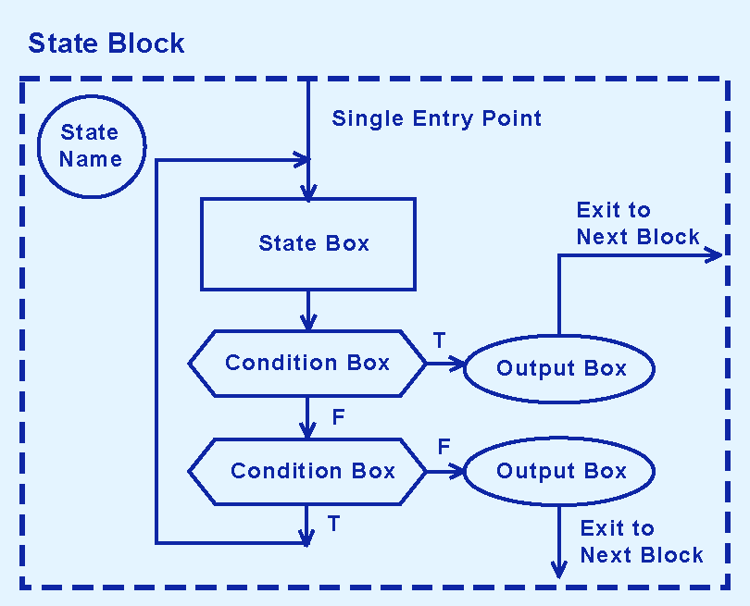
Sequential Circuits

Slide 57
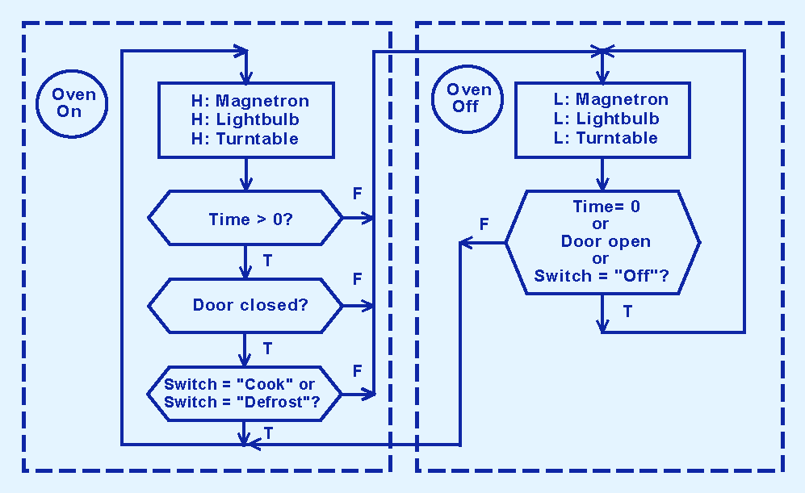
Sequential Circuits
This is an ASM for a microwave oven.

Slide 58
Sequential Circuits
Sequential circuits are used anytime that we have a “stateful” application.
  A stateful application is one where the next state of the machine depends on the current state of the machine and the input.
A stateful application requires both combinational and sequential logic.
The following slides provide several examples of circuits that fall into this category.

Slide 59
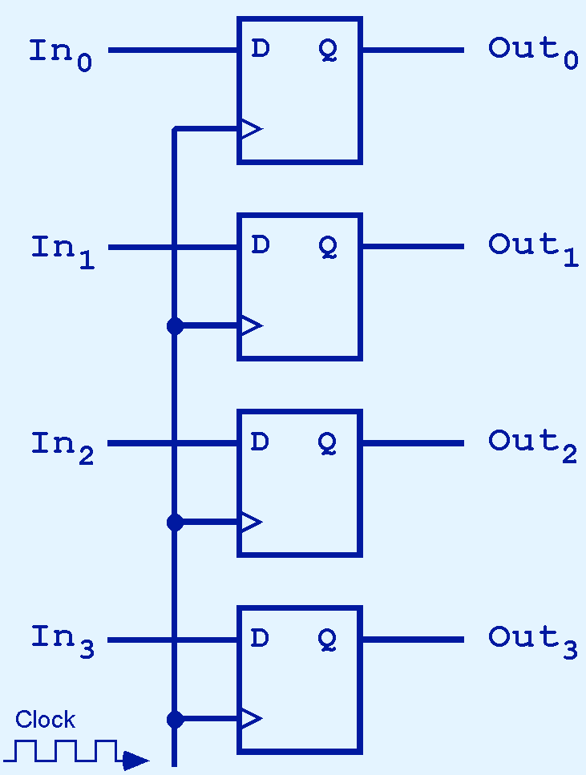
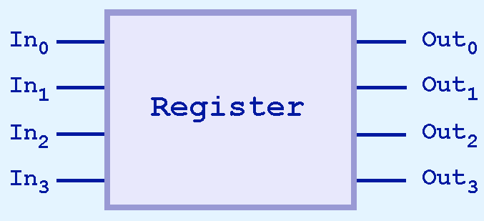
Sequential Circuits
This illustration shows a 4-bit register consisting of D flip-flops. You will usually see its block diagram (below) instead.

Slide 60

Sequential Circuits

Slide 61

Sequential Circuits
A binary counter is another example of a sequential circuit.
The low-order bit is complemented at each clock pulse.
Whenever it changes from 0 to 1, the next bit is complemented, and so on through the other flip-flops.

Slide 62
End of Chapter 3

